Slide 1
Pharmacology of the Cardiovascular System
Hypertension
Ken Wojcikowski

Slide 2
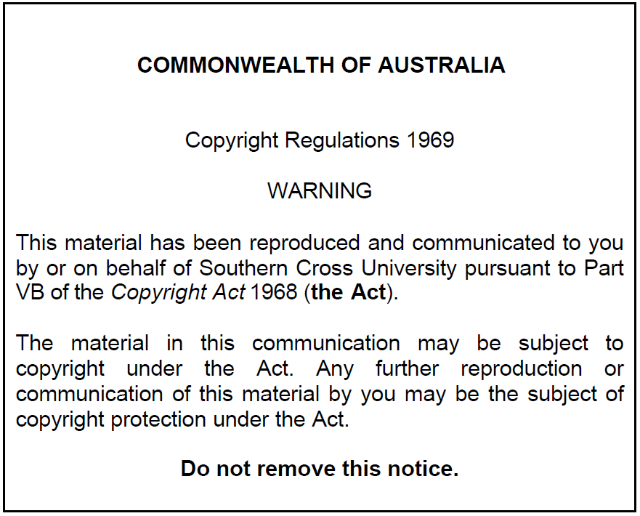
Pharmacology of the Cardiovascular System: Hypertension
Dr Ken Wojcikowski

Slide 3
PHAR2001_2_5_1
kjhkjhlkdfs
Medications of the Cardiovascular System:
Antihypertensive Medications
Lesson 1:
Introduction; Physical factors involved in blood pressure

Slide 4
Objective
Explain the regulation of blood pressure, including the short term regulation and the long term regulation.

Slide 5
Arterial Blood Pressure
Systolic pressure - arterial blood pressure generated during ventricular contraction
Diastolic pressure - arterial blood pressure generated when the ventricles are relaxed

Slide 6
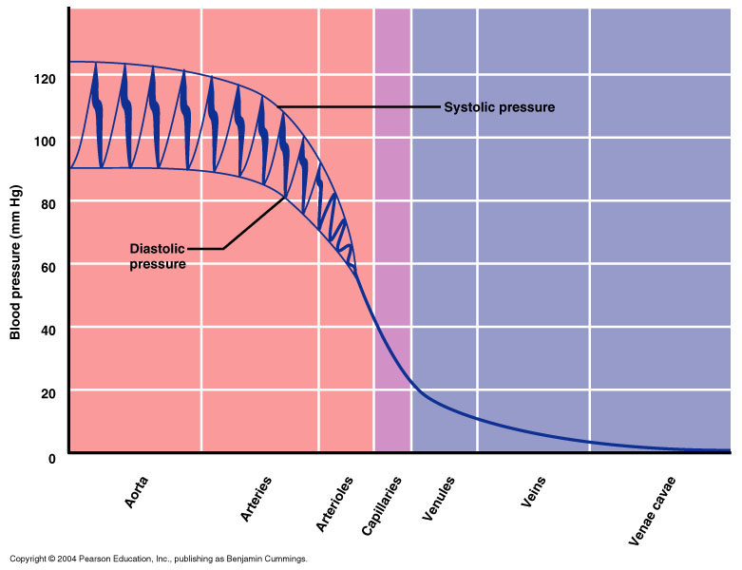

Slide 7
Factors Influencing Mean Arterial Blood Pressure
Physical
  Blood volume and the elastic properties of the blood vessels and narrowing of the blood vessels
    Therefore, pathological factors like atherosclerosis can influence blood pressure
Physiologic factors
  Cardiac output (stroke volume x heart rate)
  Peripheral vascular resistance
  (Blood pressure = Cardiac output x peripheral vascular resistance)

Slide 8
PHAR2001_2_5_1
kjhkjhlkdfs
Medications of the Cardiovascular System:
Antihypertensive Medications
Lesson 2:
Physiological factors involved in blood pressure regulation

Slide 9
Physiological Factors Influencing Blood Pressure
Blood pressure = cardiac output × peripheral vascular resistance (total peripheral resistance)
  CO
    stroke volume x heart rate
      sympathetic nervous system is most important
  PVR is dependent on three factors:
    Length of the vessel
    Viscosity of the fluid
    But mainly controlled by the diameter of the arterioles
      Sympathetic nervous system is most important

Slide 10
Resistance
Total Peripheral resistance (TPR)
Contributing factors –
  viscosity,
  length of vessel (obesity)
But resistance depends mostly on radius of the vessel
The radius of the arterioles is most important
  narrowing arterioles decrease blood pressure downstream and increase blood pressure upstream

Slide 11
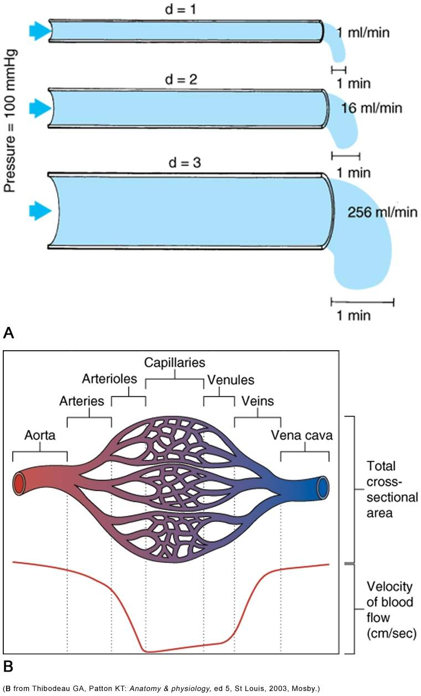
If a vessel lumen is decreased by half, it results in 1/16th the flow!
Thibodeau Anatomy and physiology 5e, St. Louis, 2003, Mosby

Slide 12
Control of Arteriole Diameter
  Arteriole diameter is most important in influencing resistance
Controllable factors that can affect arteriole diameter (resistance) and therefore affect blood flow and blood pressure include
  Neural mechanisms
  Hormonal stimulation
  Local effects

Slide 13
Review: most important factors for blood pressure regulation
Heart rate
  Mostly influenced by ANS
Stroke volume
  Volume of fluid
    ADH the water saver, aldosterone the salt saver and ANP the salt waster)
  And stroke volume
    ANS
Diameter of the arterioles
  Neural mechanisms
    ANS
  Hormonal stimulation
    ANS, angiotensin
  Local effects
    Nitric oxide, prostaglandins, other mediators

Slide 14
PHAR2001_2_5_1
kjhkjhlkdfs
Medications of the Cardiovascular System:
Antihypertensive Medications
Lesson 3:
Physiological factors involved in blood pressure regulation (cont.)

Slide 15
Hormonal stimulation
Renin angiotensin aldosterone mechanism
Any decrease in the blood flow to the kidneys results in release of Renin
Think of renin as a stress hormone released to save us from dehydration or blood loss

Slide 16
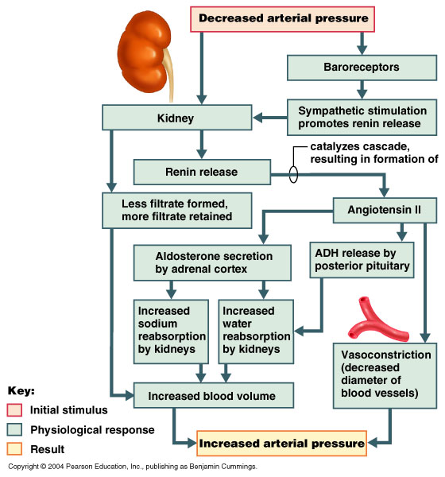

Slide 17
Control of blood pressure:
Local effects
Blood vessels have mechanisms that regulate their own blood flow
  “Autoregulation”
    Allows some organs to maintain constant blood flow between wide range of BP’s
Tissue factors contributing to local control of blood flow
  Nitric oxide; Histamine
    Increases blood flow
    Provides autoregulation in skeletal muscle

Slide 18
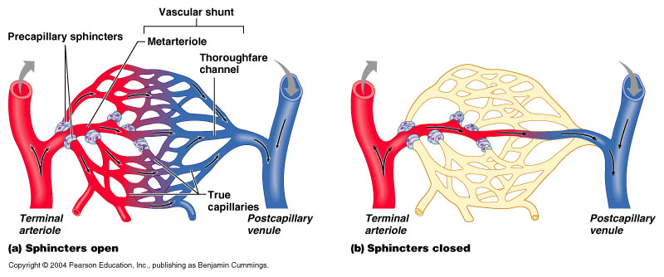
Local effects often work on precapillary sphincters

Slide 19
Control of blood pressure:
Local effects
The prostaglandins
Some cause dilation
  Prostaglandin E2
Others cause constriction
  Prostaglandin TXA2
Example:
The vasoconstriction of TXA2 from platelets… …are balanced by the vasodilation effects of endothelial- derived vasodilator, Prostacyclin I 2

Slide 20
Mechanisms of Blood Pressure Regulation
Short-term regulation: corrects temporary imbalances in blood pressure
  Neural mechanisms
  Hormonal mechanisms
Long-term regulation: controls the daily, weekly, and monthly regulation of blood pressure
  Renal mechanism

Slide 21
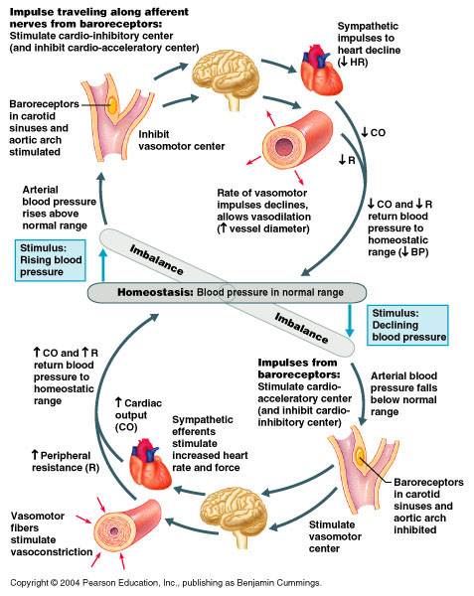
Summary of blood pressure regulation (see next two slides for enlarged version)

Slide 24
Pharmacology of the Cardiovascular System
Medications for Hypertension
Ken Wojcikowski

Slide 25
Objective
Identify and describe the therapeutic actions and major side effects of common pharmacological agents used in the treatment of hypertension

Slide 26
PHAR2001_2_5_1
kjhkjhlkdfs
Medications of the Cardiovascular System:
Antihypertensive Medications
Lesson 4:
Overview of hypertension

Slide 27

Overview of Hypertension

Slide 28
Hypertension
A consistently elevated blood pressure
equal to or greater than 140/90mmHg
Primary/essential hypertension (90-95% of cases)
Many causes:
  Lifestyle factors
  Genetics
Secondary hypertension
One cause
  Underlying disease process
  Drugs
  Hormonal factors

Slide 29
PHAR2001_2_5_1
kjhkjhlkdfs
Medications of the Cardiovascular System:
Antihypertensive Medications
Overview of antihypertensive agents

Slide 30
Medications to treat hypertension
Treatment of hypertension often involves several drugs
To help remember them, remember your A, B, C, D’s
A
B
C
D

Slide 31
Medications to treat hypertension
Alpha 1 BLOCKERS (…zosin drugs)
Alpha 2 AGONISTS (not antagonists; Methyldopa (for pregnancy)
Angiotensin converting enzyme inhibitors (…pril drugs)
Angiotensin 2 receptor blockers (ARBS; …sartan)
Beta blockers (…olol drugs)
Calcium channel blockers (Dihydropyridines)
Diuretics – Especially Hydrochlorothiazide or thiazide diuretics

Slide 32
PHAR2001_2_5_1
kjhkjhlkdfs
Medications of the Cardiovascular System:
Antihypertensive Medications
Lesson 5:
Alpha 1 antagonists

Slide 33

Alpha antagonists
Prazosin, doxazosin and other …zosin drugs
Alpha antagonists are also known as selective sympatholytic agents, alpha receptor blockers
  Block alpha 1 receptor sites on blood vessels
    Decreased sympathetic stimulation to blood vessels
    Decreased vascular tone
    Vasodilation
    Decreased vascular resistance
    Decreased BP
Location of receptors:
Blood vessels
Prostate
Urinary sphincters
https://www.telegraph.co.uk/news/newstopics/howaboutthat

Slide 34
Alpha antagonists
Prazosin, doxazosin and other …zosin drugs
Alpha antagonists are no longer the preferred medication for hypertension or benign prostatic hyperplasia.
They may be best placed in people who have both BPH and hypertension at the same time.
Location of receptors:
Blood vessels
Prostate
Urinary sphincters
https://www.telegraph.co.uk/news/newstopics/howaboutthat

Slide 35
Alpha antagonists
Block the alpha receptors located on arterioles and pre-capillary sphincters so that the SNS cannot
  Lowers systemic vascular resistance.
Preventing SNS activity on blood vessels and precapillary sphincters decreases blood pressure

Slide 36
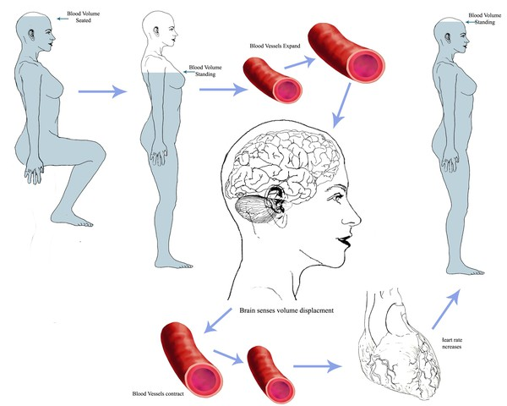
Alpha antagonists
Alpha antagonists are also known as selective sympatholytic agents, alpha receptor blockers
Block receptors on prostate/ urinary sphincters
  Potentially useful in Benign prostatic hyperplasia
Adverse effects:
  ORTHOSTATIC HYPOTENSION!!
  Syncope
  Dizziness
Prazosin (Minipress)

Slide 37
Orthostatic (postural) hypotension
Important safety issue!
Teach client how to
get up from a seated
position safely!

Slide 38
PHAR2001_2_5_1
kjhkjhlkdfs
Medications of the Cardiovascular System:
Antihypertensive Medications
Alpha 2 agonists (Methyldopa for use during pregnancy: see end of lesson 8)

Slide 39
PHAR2001_2_5_1
kjhkjhlkdfs
Medications of the Cardiovascular System:
Antihypertensive Medications
Lesson 6:
Angiotensin system medications:
Medications of the Renin Cascade

Slide 40
.
Medications of the Renin Cascade
Angiotensin-converting enzyme (ACE) inhibitors
…PRIL DRUGS including Ramipril
Angiotensin II receptor blockers (ARBS)
…SARTAN drugs like Candesartan

Slide 41
.
Understanding the Renin Cascade
Think of renin as the panic button to simultaneously increase blood pressure by every means available
When our blood pressure is too low, or there is sympathetic nervous system stimulation to the kidneys, renin is released.
The ultimate effect is an increase of the blood pressure by at least 5 mechanisms
Our medications of the renin cascade attempt to stop this cascade at two different points

Slide 42
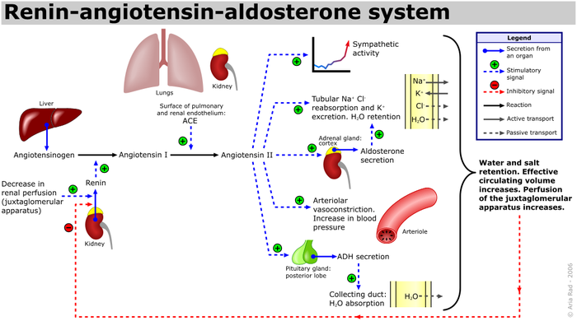
.
Soupvector, CC BY-SA 4.0

Slide 43
.
ACE inhibitors
work here
ARBs
work here
Soupvector, CC BY-SA 4.0

Slide 44
.
Medications of the Renin Cascade
Renin-angiotensin aldosterone system
ACE inhibitors inhibit the conversion of angiotensin I to angiotensin II
ARBs antagonise the Angiotensin II receptors
Both:
  Decrease aldosterone the salt saver
  Decrease ADH, the water saver
  Decreases vasoconstriction
  Increase fluid released from kidneys
  Decrease the renin-controlled SNS ‘positive feedback’ loop

Slide 45
.
Angiotensin converting enzyme inhibitors
ACE inhibitors inhibit the conversion of angiotensin I to angiotensin II
Ramipril and other …PRIL drugs
Indicated in congestive heart disease and hypertension
Adverse effects:
  Chronic dry cough,
  Hyperkalaemia
Contraindicated in pregnancy (Category D)

Slide 46
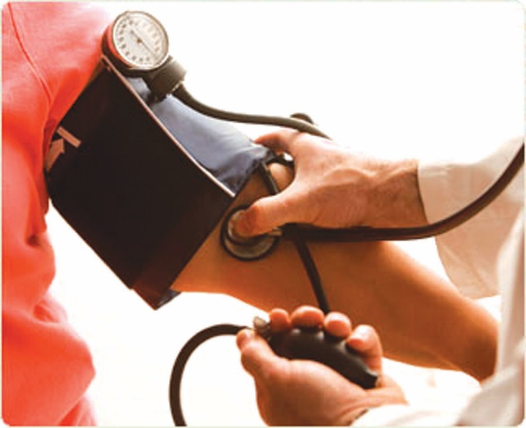
.
Angiotensin II receptor blockers
Bind to angiotensin II receptors blocking the effect
Candesartan and other …SARTAN drugs
Indicated in Congestive Heart Disease and hypertension and PRE-HYPERTENSION!
Adverse effects:
  Fewer than ACE inhibitors
  GI disturbances
Contraindicated in pregnancy
  Pregnancy category D

Slide 47
PHAR2001_2_5_1
kjhkjhlkdfs
Medications of the Cardiovascular System:
Antihypertensive Medications
Lesson 7:
Beta blockers

Slide 48
.
Beta blockers
Beta blockers are sympathetic antagonists, sympatholytics, beta receptor blockers
  Example: Atenolol and other …OLOL drugs
  Block Beta 1 receptor sites on the heart
  Decreased sympathetic stimulation to the heart
  Decreased heart rate (negative chronotropic effect)
  Decreased contractility (negative inotropic effect)
There are at least 4 drug classes that are better!
Taper these drugs off slowly or a rebound hypertension may develop
Location of receptors:
Heart
Kidney (renin release)
https://www.telegraph.co.uk/news/newstopics/howaboutthat

Slide 49
.
Beta blockers – third generation
Carvedilol is considered a third generation beta blocker but does not have the …olol suffix due to having alpha 1 blocking properties.
Indicated in high blood pressure, congestive heart failure (CHF) but not the first line therapy, due to side effects in over 10% of individuals taking carvedilol:
Dizziness, Fatigue, Low blood pressure
Diarrhea
Weakness
Bradycardia
Weight gain
Erectile dysfunction
Location of receptors:
Heart AND
Blood vessels
https://www.telegraph.co.uk/news/newstopics/howaboutthat

Slide 50
PHAR2001_2_5_1
kjhkjhlkdfs
Medications of the Cardiovascular System:
Antihypertensive Medications
Lesson 8:
Calcium channel blockers

Slide 51
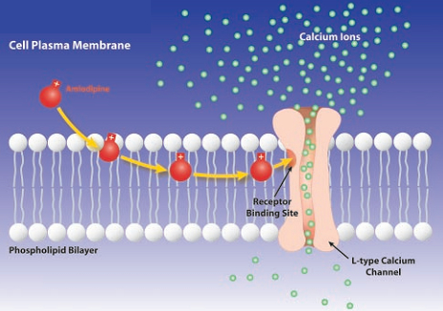
.
Calcium channel blockers
Reduction in calcium inside the cells
  Reduced cardiac contractility
  Vasodilation, which reduces myocardial workload
Adverse effects:
  Peripheral oedema
  Dizziness, headaches
  Hypotension
  Bradycardia
Amlodipine,
Nifedipine during pregnancy
But both CCBs are pregnancy category C
https://pharmacologycorner.com/calcium-channel-blockers

Slide 52
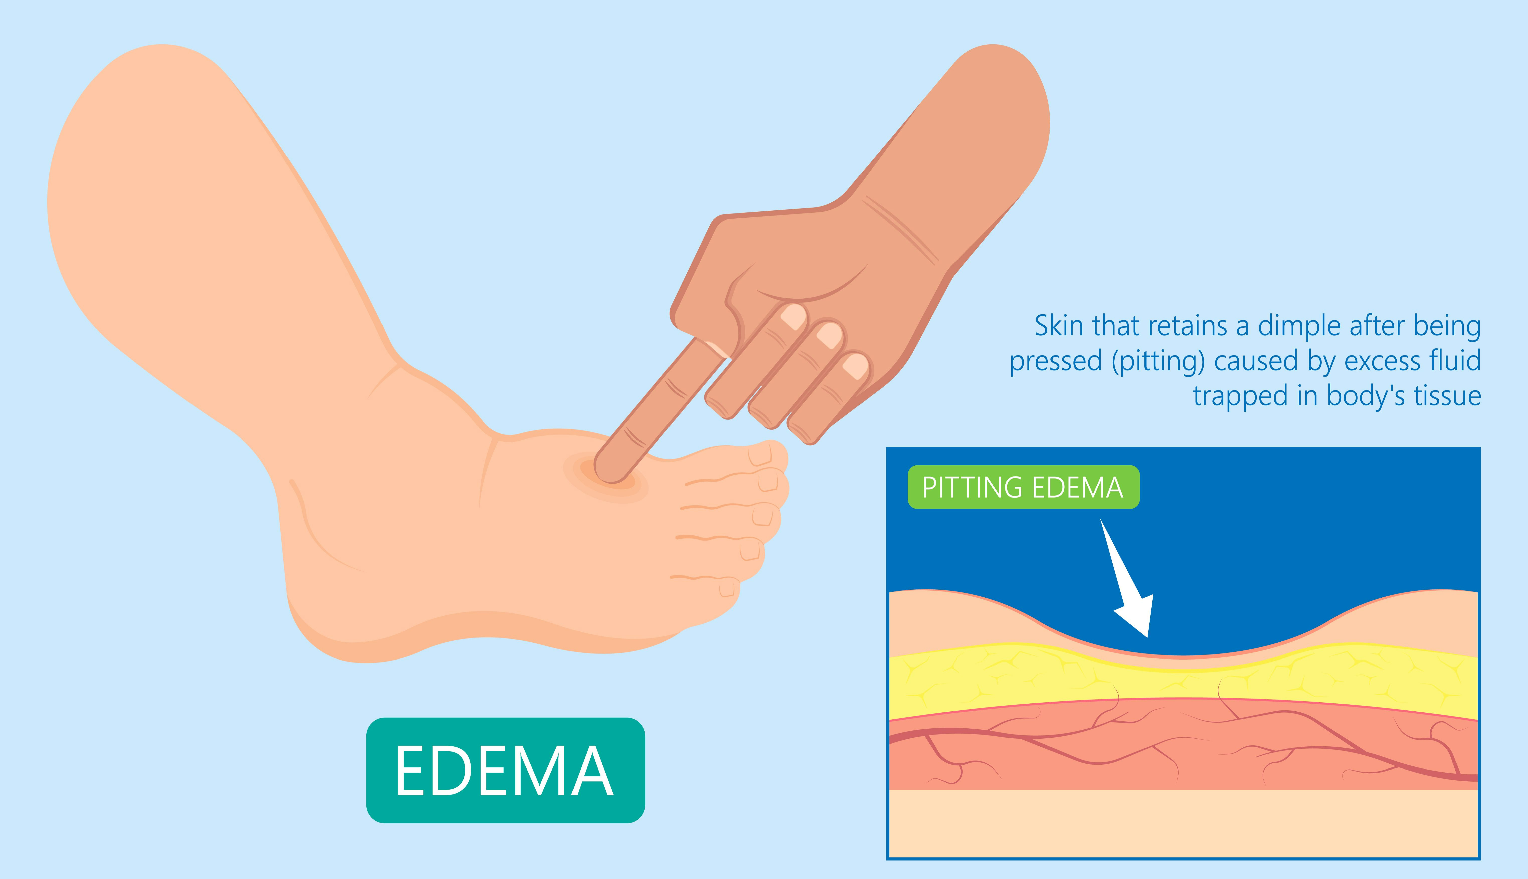
.
Calcium channel blockers cause oedema
May be combined with a diuretic, ACE inhibitor or ARB to decrease oedema

Slide 53
.
Other antihypertensives during pregnancy
Methyldopa is a pregnancy category A drug
Indicated in hypertension during pregnancy, gestational pregnancy, pre-eclampsia
  not generally used in other settings
It is an alpha 2 agonist*
  *not an antagonist, remember this receptor is the ‘negative feedback receptor’ that we put off to the side when talking about sympathomimetics – it does the opposite thing that we would expect a sympathomimetic to do
Methyldopa causes many psychological side effects and is normally not used outside pregnancy

Slide 54
PHAR2001_2_5_1
kjhkjhlkdfs
Medications of the Cardiovascular System:
Antihypertensive Medications
Lesson 9: Overview of diuretics / Final words about hypertension
(For full diuretics discussion, please refer to the final chapter in this module.)

Slide 55
Diuretics
Inhibit sodium reabsorption from the kidney
Salt stays in the nephron, and is excreted along with the water that it pulls along with it.
Some diuretics actually result in compensation, thereby negating the blood pressure lowering effects.
Thiazide diuretics are a first line therapy for hypertension
Can be combined with other antihypertensive agents for greater efficacy.

Slide 56
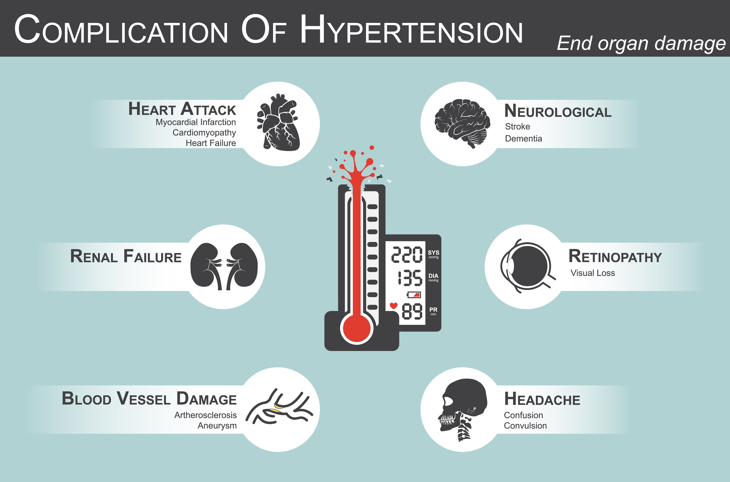
Final words about treating hypertension
Initially, diet and lifestyle changes
Next, one of the first line therapies
  ACE inhibitors or ARBs
  Calcium channel blockers
  Thiazide diuretics
Then, more than one of the above.

Slide 58
Thiazide diuretics (hydrochlorothiazide)
Inhibit sodium reabsorption from the distal tubule
Wastes potassium as well
Used for hypertension, congestive heart failure, nephrolithiasis and diabetes insipidus
Thiazide diuretics compete with the secretion of uric acid so they are contraindicated in people with gout
Several drugs use hydrochlorothiazide in combination to prevent – a little bit increases the action of other
    Hydrochlorothiazide (Dithiazide)

Slide 59
.
Summary by mode of action
Decrease heart rate and force
  Beta blockers
  Alpha and beta adrenergic blockers
Decrease vascular resistance
  Alpha antagonists,
  ACE inhibitors,
  Calcium channel blockers,
  Alpha and beta adrenergic blockers,
  Angiotensin II receptor blockers
Decrease plasma volume
  Angiotensin II receptor blockers
  Diuretics
  ACE inhibitors

Slide 60
.
References
Thibodeau GA, Patton KT: Anatomy and Physiology 5th ed. Mosby, St. Louis 2003
//upload.wikimedia.org/wikipedia/commons/c/cb/Thyroid_system.png
Soupvector, CC BY-SA 4.0 <https://creativecommons.org/licenses/by-sa/4.0>, via Wikimedia CommonsRoyalty free images from Shutterstock
McCance K, Huether S: Pathophysiology: The biological basis for disease in adults and children 8th ed. Mosby St Louis 2018
https://pharmacologycorner.com/calcium-channel-blockers-classification-mechanism-of-action-indications/
https://www.telegraph.co.uk/news/newstopics/howaboutthat
Marieb EN et al. Human Anatomy and Physiology 6th ed. Pearson Education publishing as Benjamin Cummings 2004
Patton KT, Thibodeau GA: Mosby’s Handbook of Anatomy and Physiology Mosby, St. Louis 2006
Royalty free images from Shutterstock
The PowerPoint and associated Video were edited and produced by Dr. Ken Wojcikowski

